Slide 1

SESHADRI RAO GUDLAVALLERU ENGINEERING COLLEGE (An Autonomous Institute with Permanent Affiliation to JNTUK, Kakinada) Seshadri Rao Knowledge Village, Gudlavalleru – 521356, Krishna District DEPARTMENT OF ELECTRONICS AND COMMUNICATION ENGINEERING INDUSTRIAL/PRACTICAL TRAINING REPORT on SMART EMPLOYEE TRACKING SYSTEM
Project Batch : ECE-IOT-012
Presented By:
19481A0487 - JAYANTH KADAKUDITI
19481A0468 - MANI KOTAIAH GOBATHINA
20485A0414 - NAZIYA PARVEEN
19481A0490 – KRISHNA REDDY
19481A0488 – KAKI KARTHIK

Slide 2
Objectives of the project:
The main objective of this project to establish a system to track all the employees in the organization.
To reduce the time to manage all the employees in the company.
To make all the employees engaged in their work.
To track the employees for their location at the workplace.

Slide 3
ABSTRACT:
Nowadays it is a major task for companies to track all the employees and engage them all in their work for the development of the organization. Smart employee tracking system is a solution for this problem which makes the process of tracking the employees easy. In this technique, we can able to track and monitor the employees in the workplace.
This system has a provision for admin to track the employees in workspace and can engage them to work efficiently.
It consists an employee database, when the admin logged in and enter the employee id, if the id is in database then the web UI shows the employee location in the workspace, if id is not matched with the database it shows invalid employee id.

Slide 4
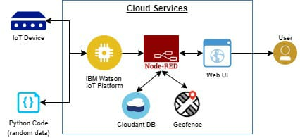
Block diagram:

Slide 5
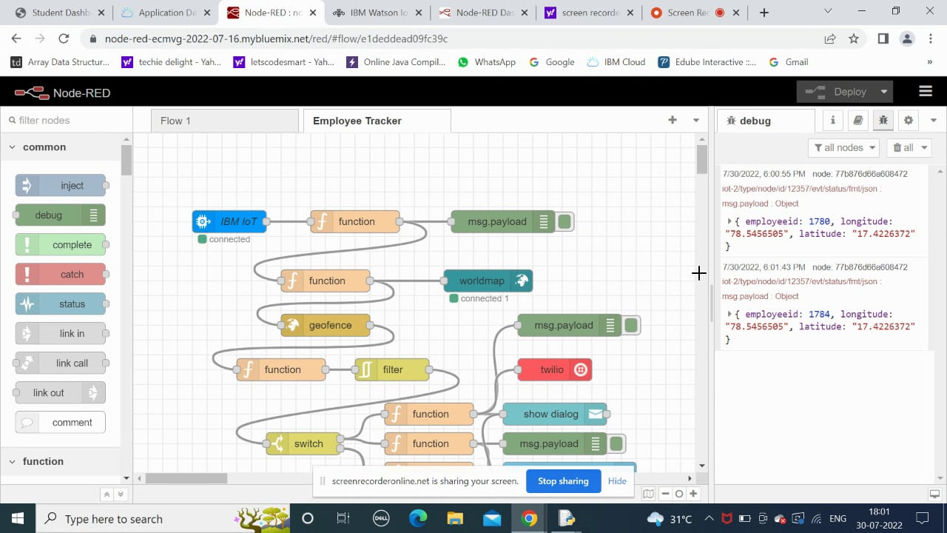
NODE – RED FLOW:

Slide 6
SKILLS REQUIRED:
Python.
IOT Cloud Platform.
IBM.
IBM Cloud.
Node – Red.

Slide 7
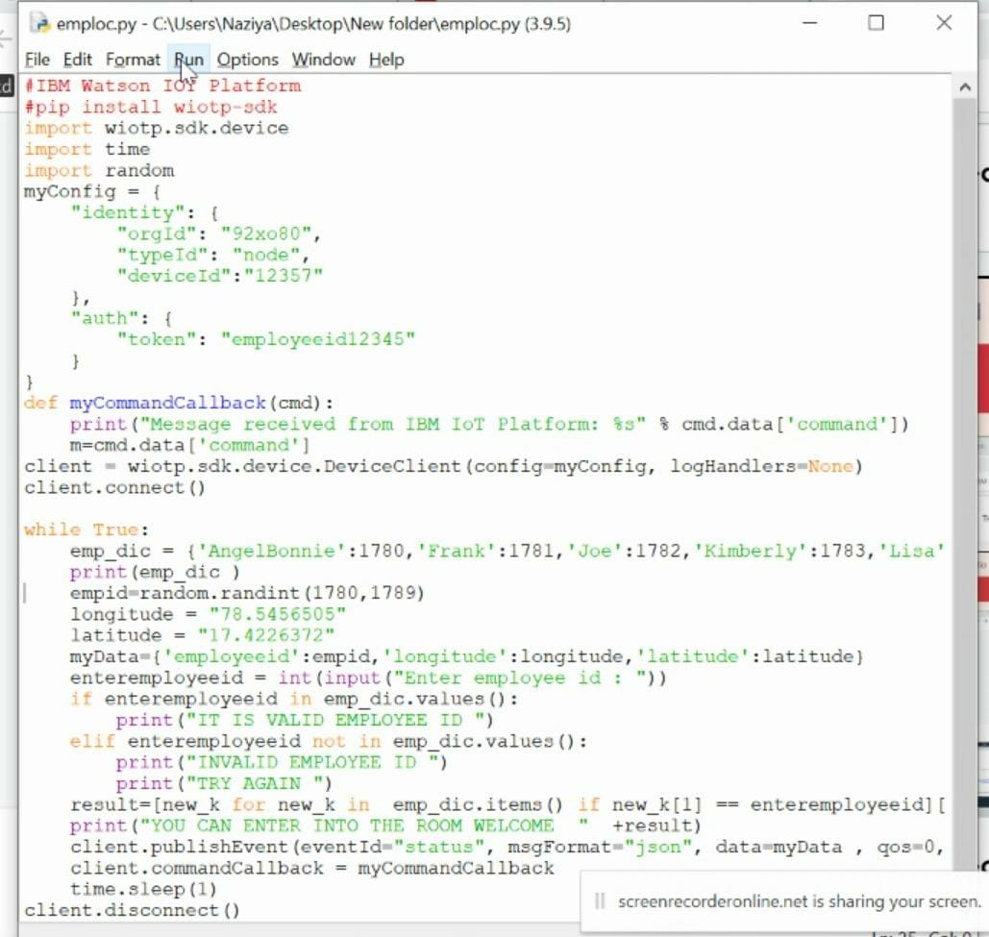
PYthON CODE:

Slide 8
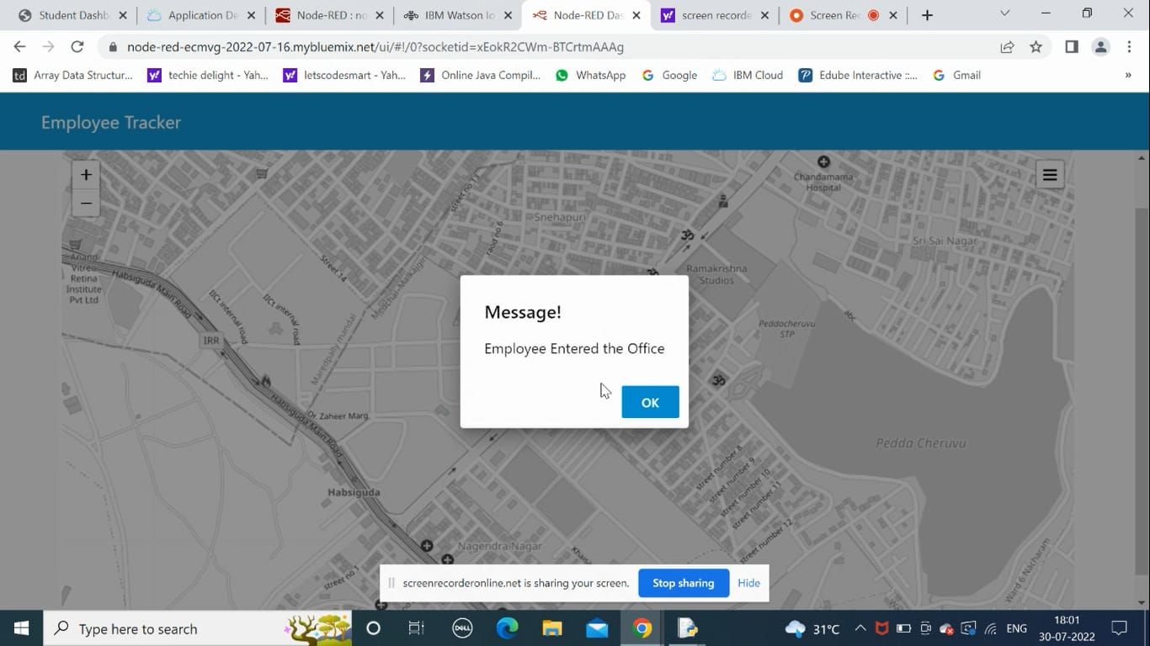
RESULT:

Slide 9
ADVANTAGES:
1. This System helps the admin to keep track of the employee’s who go for field work. Since the location of employee is tracked in that Geo-fence area.
2. It helps the employees by restricting them to not go to unsafe zones in the workplace.
DISADVANTAGES:
1. By keen monitoring of the employees, it creates a bit pressure for the employees to work freely.
2. It is difficult to track the location of the employees for the admin, if the beacon at the employee is working not properly.

